Slide 1
Introduction to Glioblastoma
Chris Plaisier
Introduction to Systems Biology Course
Institute for Systems Biology

Slide 2
Systems Level Integration
Integration of high-throughput technologies is a common practice in systems biology
In these tutorial sections we will explain and then have a hands-on time to get experience working with high-throughput data
Tutorials will focus on the deadly brain cancer glioblastoma multiforme or glioma

Slide 3
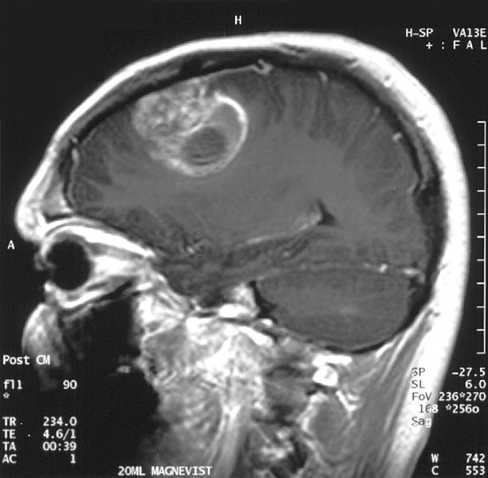
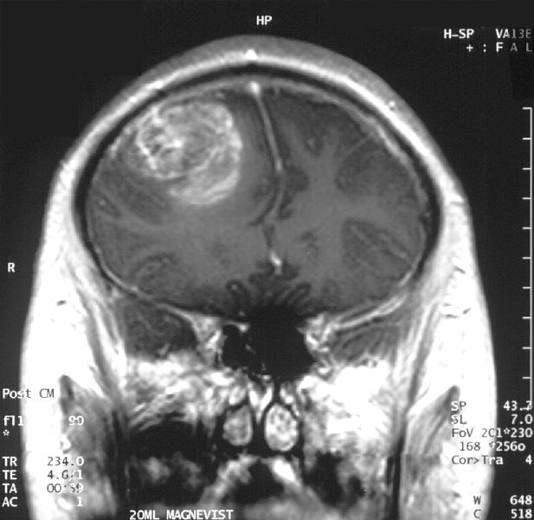
Glioma: A Deadly Brain Cancer
Wikimedia commons
Notes:
3

Slide 4
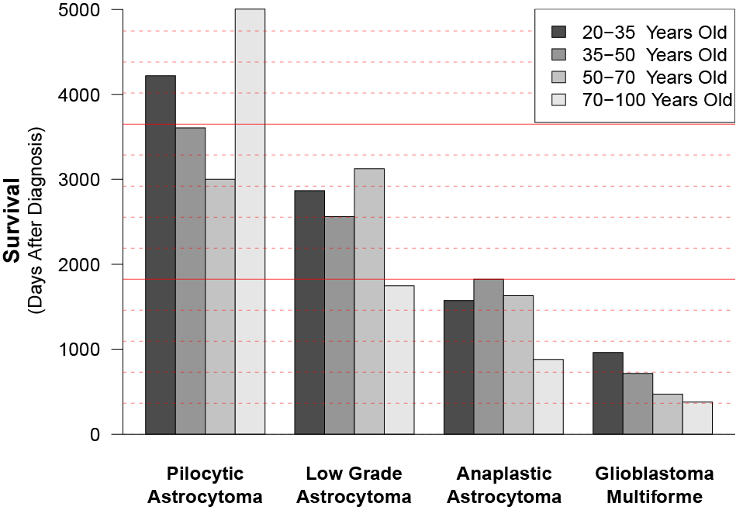
Glioma Survival
10 years
5 years
Grade I
Grade II
Grade III
Grade IV
http://www.neurooncology.ucla.edu/

Slide 5
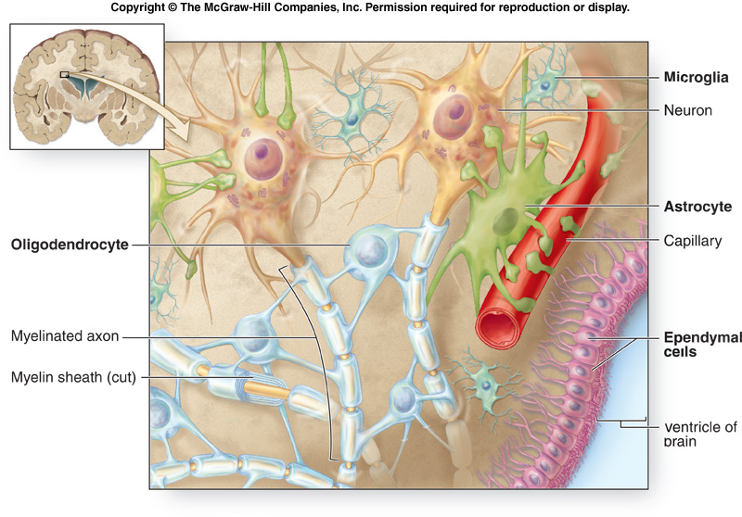
Neurophysiology
Notes:
5

Slide 6
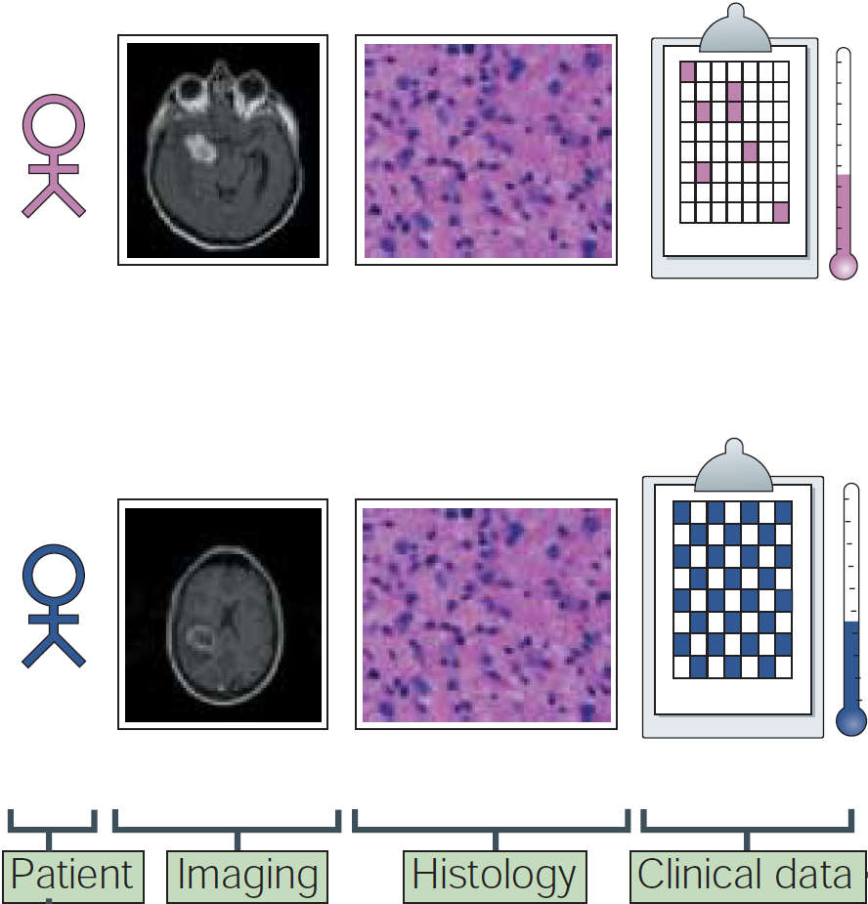
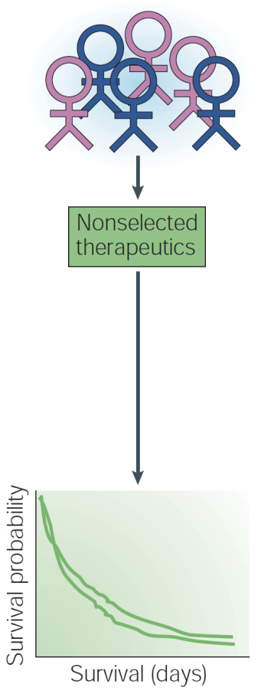
Heterogeneity of Tumors
Mischel et al, 2004

Slide 7
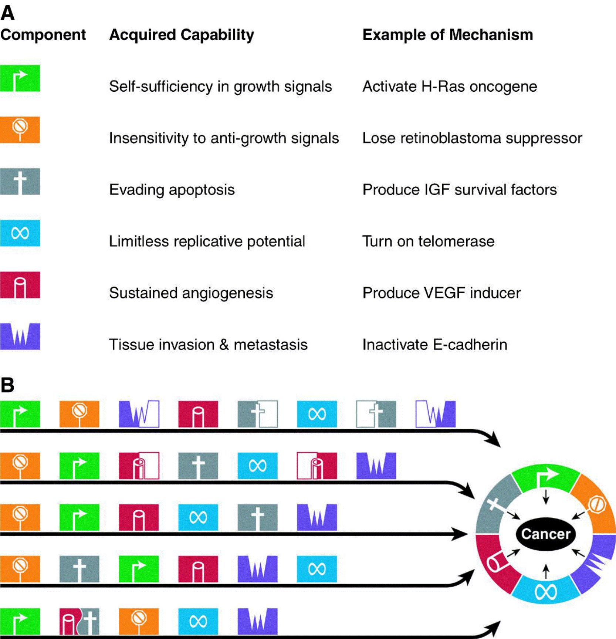
Hallmarks of Cancer
Hanahan et al. 2000

Slide 8
Parallel Pathways of Tumorigenesis
Acquisition of hallmarks may vary mechanistically and chronologically:
Hanahan et al. 2000

Slide 9
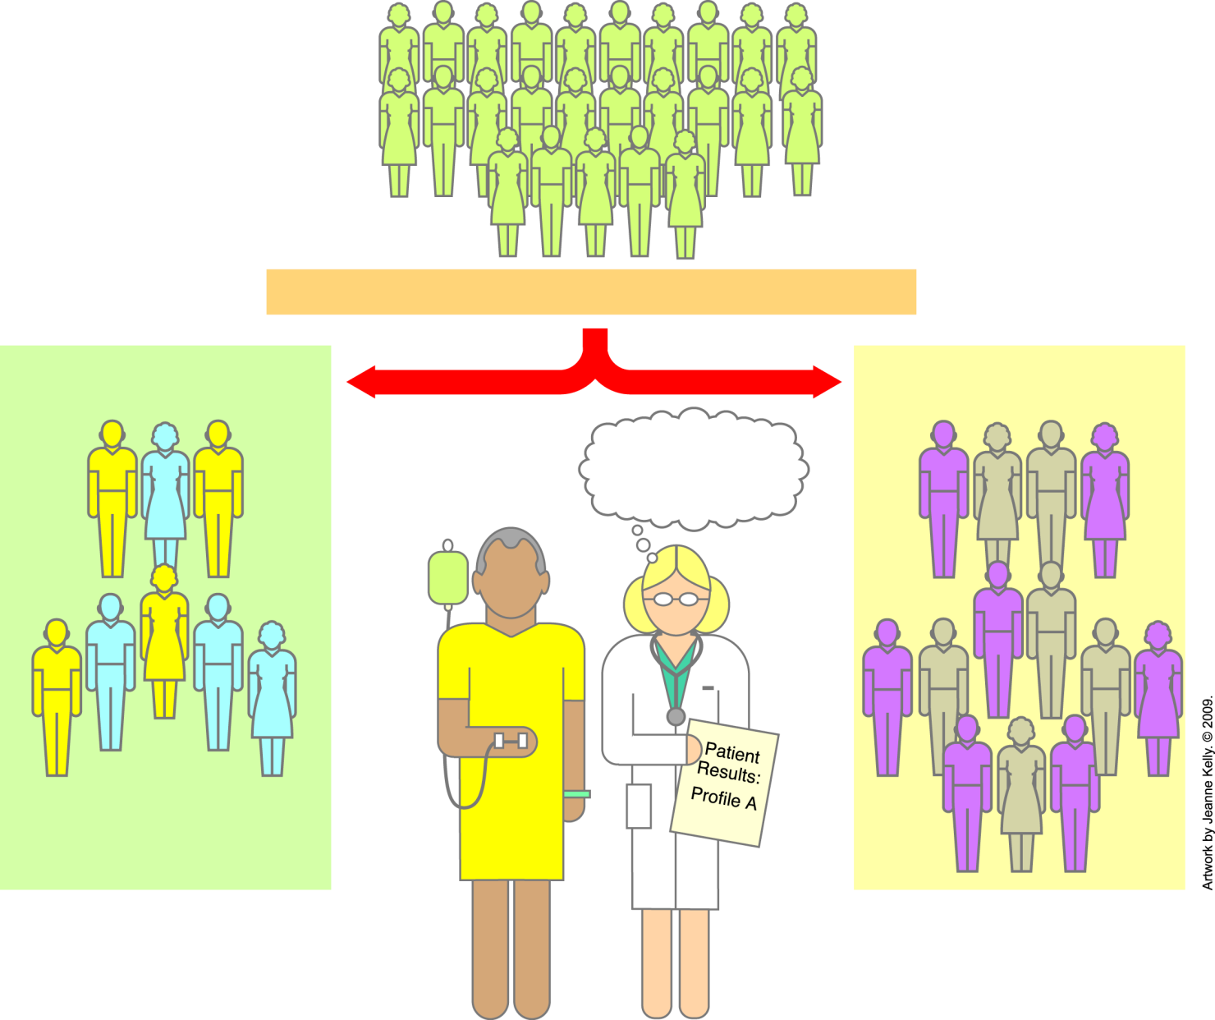
Can Genome-Wide Profiles
Inform Cancer Treatment Planning?
Colon cancer patients
Individual genome-wide profiles are sorted
Do not have mutated K-ras gene
Have mutated K-ras gene
Profile A...
give targeted therapy A
A
E
A
B
C
C
B
A
B
C
A
E
E
E
B
C
C
B
B
C
B
Respond to targeted therapy A
Notes:
Yes, although most attempts to do this are occurring within clinical trials. If therapies are available that target genes, proteins, or pathways that appear, on the basis of genome-wide profiling, to be altered in tumors, these can be used to try to treat the patient. Researchers and clinicians are also analyzing large genomic profile databases to help match patients to the best possible treatments. The genomic profile of a newly diagnosed patient is compared with previous patients’ genomic profiles, which are linked to information about how these patients were treated and responded to their treatment. This approach will allow newly diagnosed patients to be given treatments that were effective against cancers with similar genetic profiles.

Slide 10
Utility of Patient Stratification
Mischel et al, 2004

Slide 11
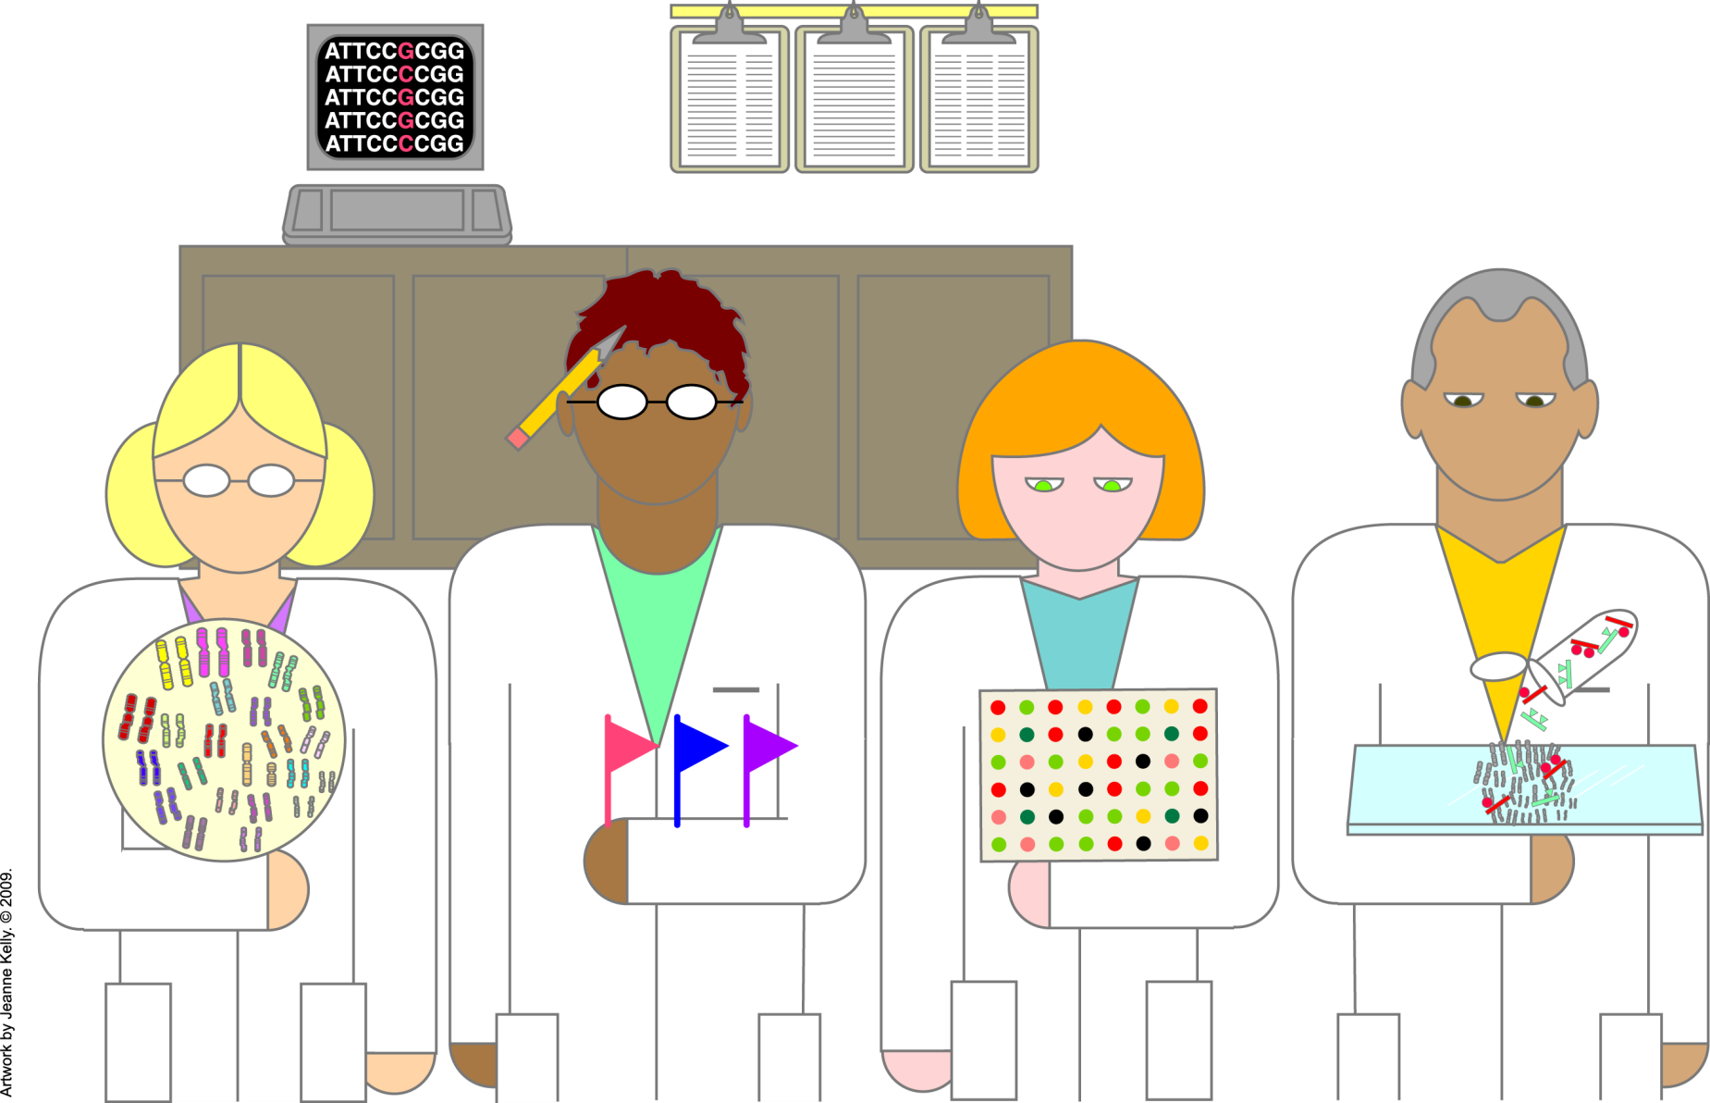
Genome-Wide Profiling: Many Ways
Notes:
Genome-wide profiling refers to the collection of large-scale information about the sequence and expression of the genes in normal or tumor cells. Techniques include:
• Comparative Genomic Hybridization and Spectral Karyotyping looking at global changes in chromosome structure when cancer cells are compared to normal tissues from the same patient
• Polymorphism Analysis looking at sets of genetic variations called polymorphisms in individuals and in populations (These specific altered regions or sequences are spread across the entire genome.)
• Gene Expression Profiling capturing total gene activities, both increases and decreases, across a genome as patterns of gene expression
Most of these techniques use high-throughput technologies, which are automated systems that can perform rapid analysis of large numbers of samples in a short period of time. Genomic signatures or genomic profiles that are validated can be used to identify a specific tumor type in new tissue samples.

Slide 12

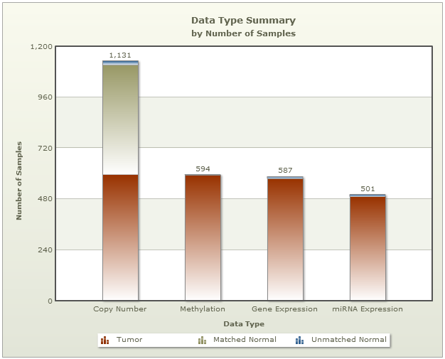

Slide 13
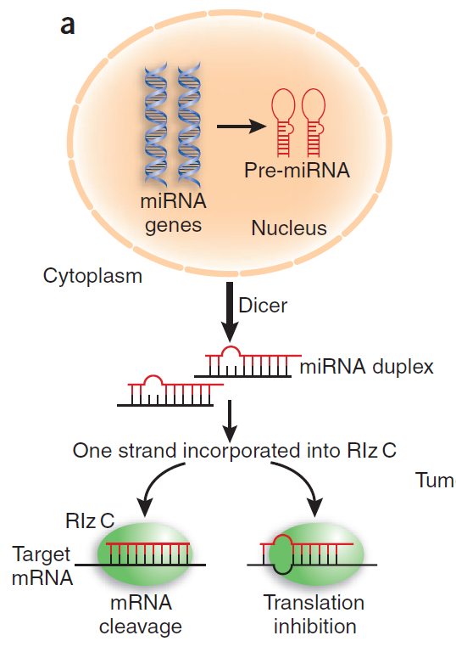
miRNAs in Cancer
RISC
Caldas et al., 2005

Slide 14
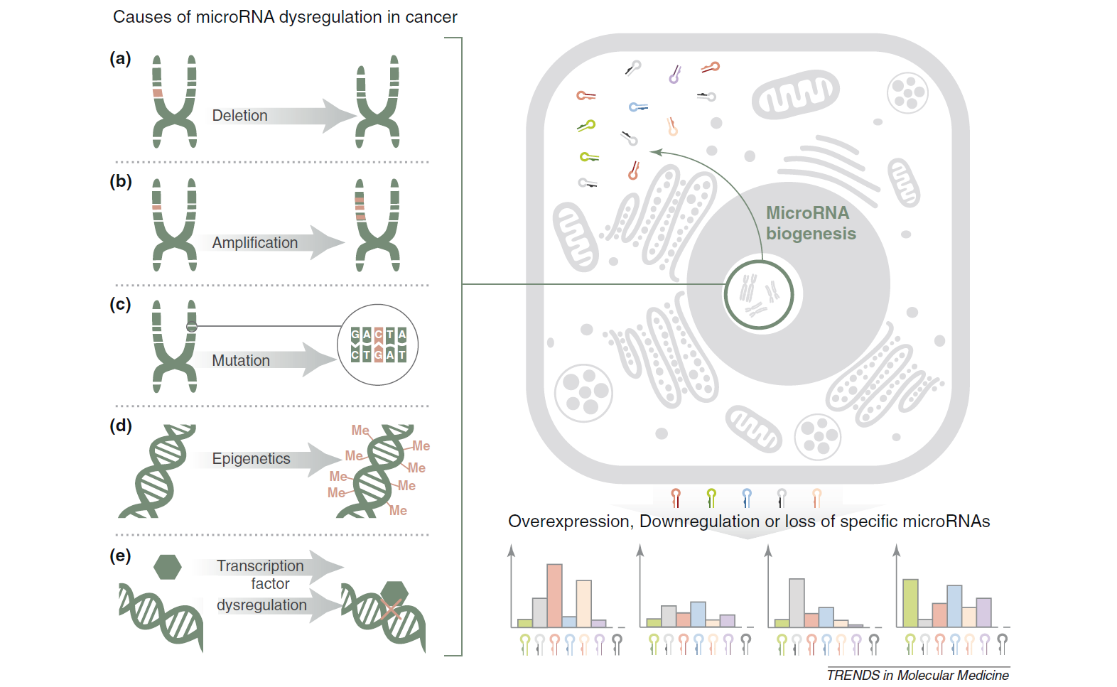
miRNAs are Dysregulated in Cancer
Chan et al., 2011

Slide 15
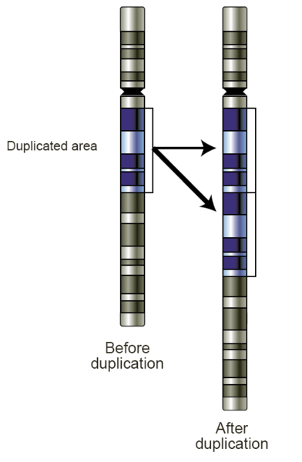
Copy Number Variation
Compare normal tissue vs. cancerous
Amplifications
Deletions
Translocations
wikipedia.org

Slide 16
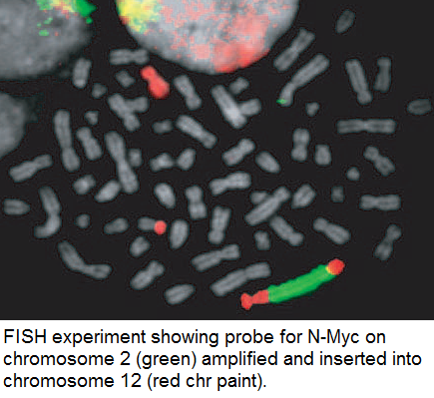
Oncogene Amplification
http://www.cambridgebluegnome.com/copy_number_imbalance

Slide 17
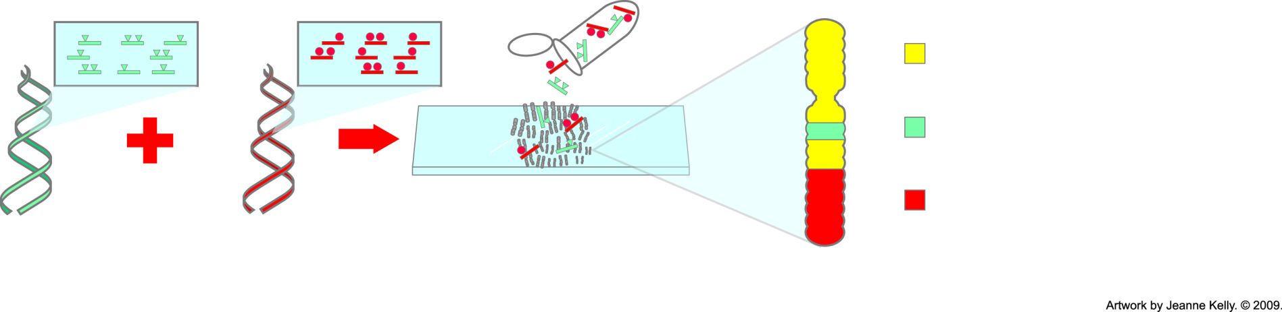
Genome-Wide Profiling:
Comparative Genomic Hybridization
= equal binding of labeled normal and tumor probes
= more binding of labeled tumor probes—gain of tumor DNA
= more binding of labeled normal probes—loss of tumor DNA
Label probes for all tumor DNA
Label probes for all normal DNA
Hybridize to normal metaphase chromosomes for 48—72 hours
Metaphase chromosome
Notes:
Comparative genomic hybridization (CGH) is a method that allows researchers to detect large-scale changes in chromosomes. They can visualize where extra genetic material (repeating copies) has been added or deleted. They can see where large portions of genetic material have been inserted into chromosomes. Many cancers exhibit these types of chromosomal abnormalities.

Slide 18
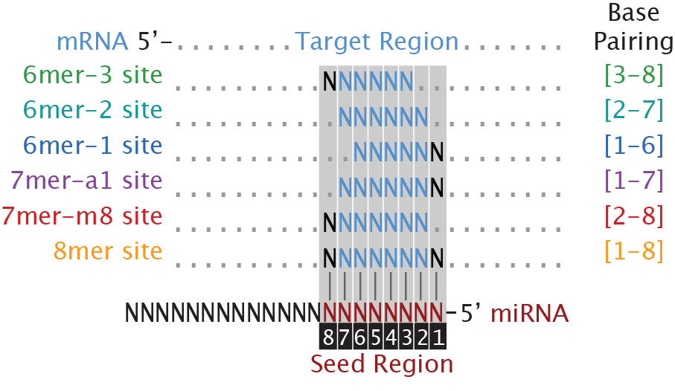
miRNAs are Trans-Acting Factors

Slide 19
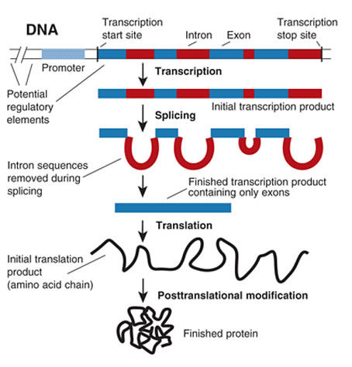
Gene Expression
http://www.news-medical.net/health/What-is-Gene-Expression.aspx

Slide 20
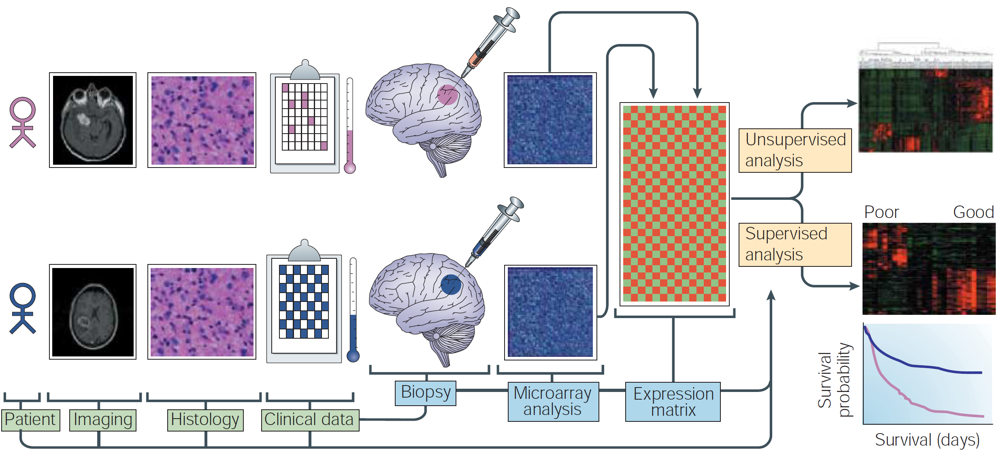
Stratification of Patients
Mischel et al, 2004

Slide 21
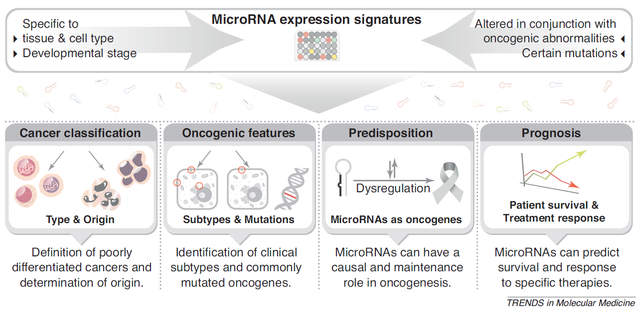
Utility of miRNAs in Cancer
Chan et al., 2011

Slide 22
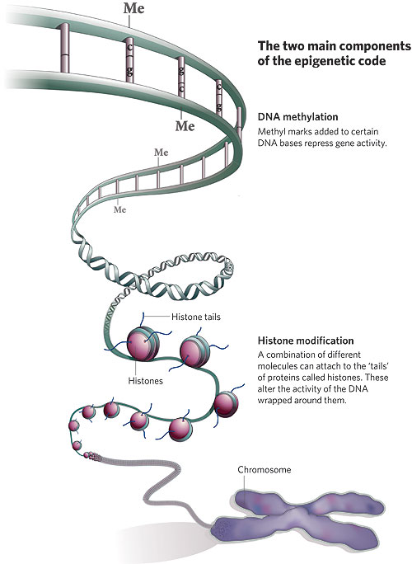
DNA Methylation
Methylation patterns modify the expression of genes
Methylation has been linked to cancer

